Slide 1

Digital Design
With an Introduction to the Verilog HDL, VHDL, and SystemVerilog 6th Edition
Chapter 05
Synchronous Sequential Logic
Analysis of Clocked Sequential Circuits

Slide 2
Analysis of Clocked Sequential Circuits
Goal:
to determine the behavior of clocked sequential circuits
Inputs
Outputs
State of the flip-flops
We have to obtain
Boolean expressions for output and next state
output & state equations
(state) table
(state) diagram

Slide 3
Example 1
Q(t+1) = D
A(t+1) = B(t+1) = y =
A(t+1)
D
Q
A
x
C
A’
B(t+1)
D
Q
B
C
B’
y
clk

Slide 4
Example 1: State (Transition) Table
A(t+1) = ?
B(t+1) = ?
y = ?
Present state
input
Next state
output
A
B
x
A
B
y
0
0
0
0
0
1
0
1
0
0
1
1
1
0
0
1
0
1
1
1
0
1
1
1

Slide 5
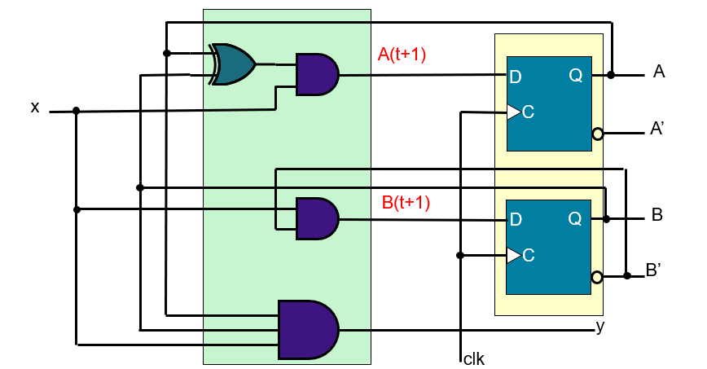
Example 1: State (Transition) Table
A(t+1) = X(A⊕B)
B(t+1) =X B’
y = X A B
Present state
input
Next state
output
A
B
x
A
B
y
0
0
0
0
0
0
0
0
1
0
1
0
0
1
0
0
0
0
0
1
1
1
0
0
1
0
0
0
0
0
1
0
1
1
1
0
1
1
0
0
0
0
1
1
1
0
0
1

Slide 6
Example 1: State Diagram
Present state |  | input | Next state |  | output
A | B | x | A | B | y
0 | 0 | 0 | 0 | 0 | 0
0 | 0 | 1 | 0 | 1 | 0
0 | 1 | 0 | 0 | 0 | 0
0 | 1 | 1 | 1 | 0 | 0
1 | 0 | 0 | 0 | 0 | 0
1 | 0 | 1 | 1 | 1 | 0
1 | 1 | 0 | 0 | 0 | 0
1 | 1 | 1 | 0 | 0 | 1
0/0
1/1
00
0/0
11
1/0
0/0
0/0
1/0
01
10
1/0
State diagram provides the same information as state table

Slide 7
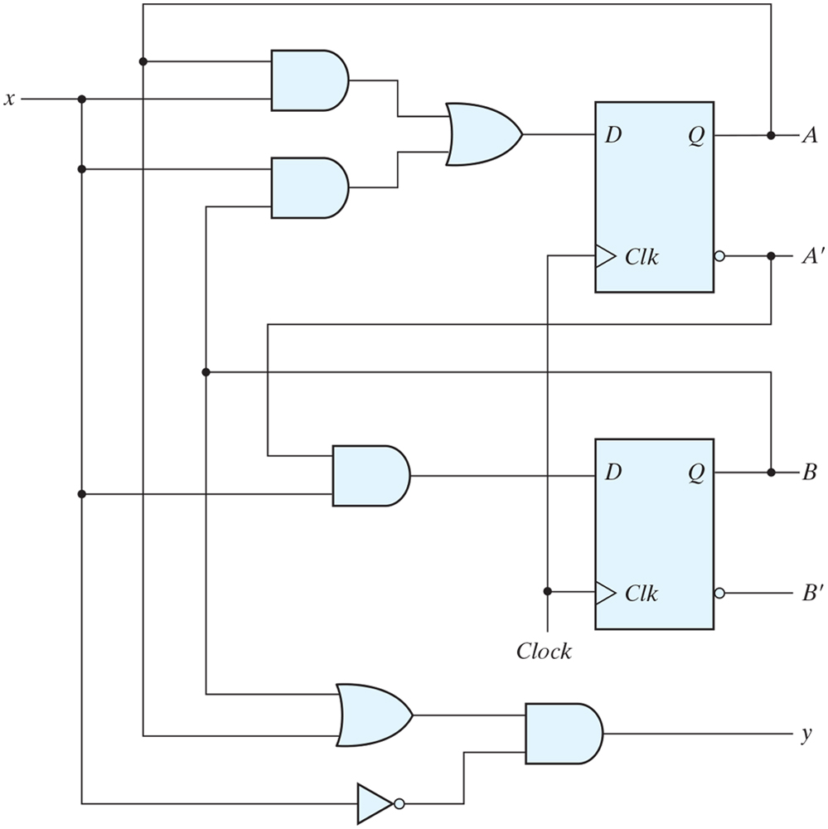
Example 2

Slide 8
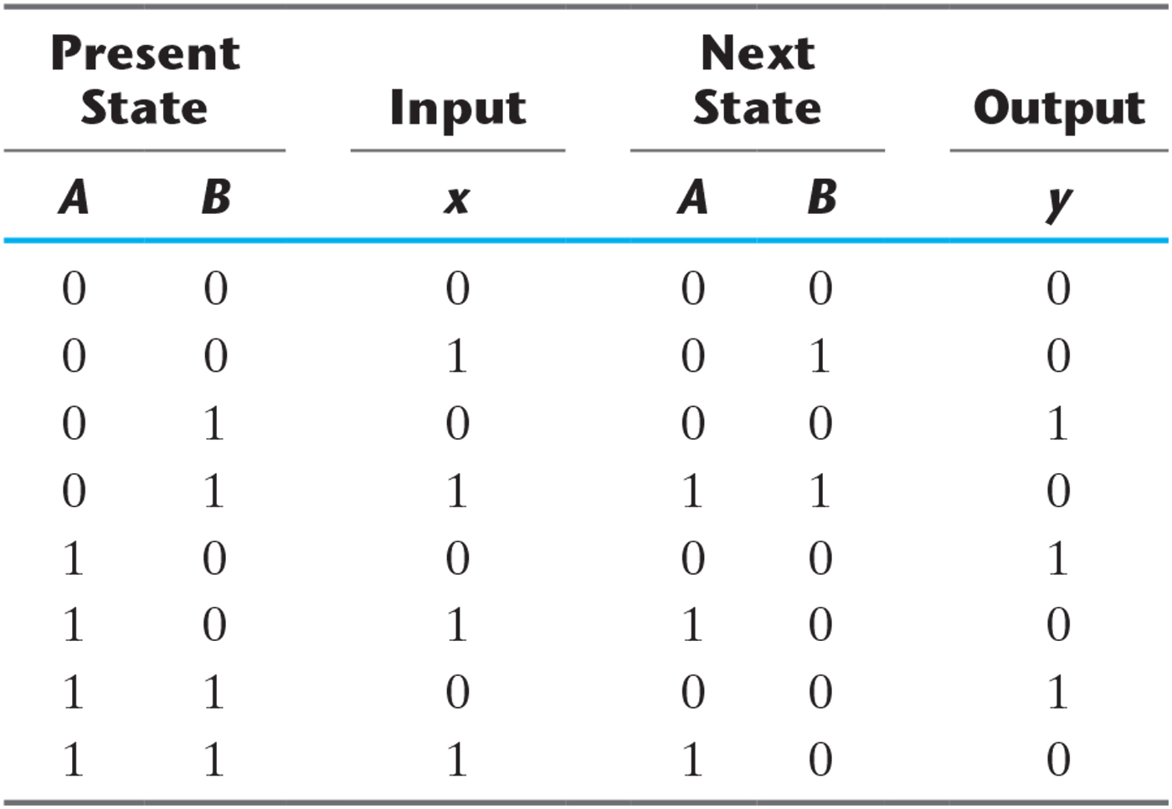
State Table for the Circuit of Example 2

Slide 9
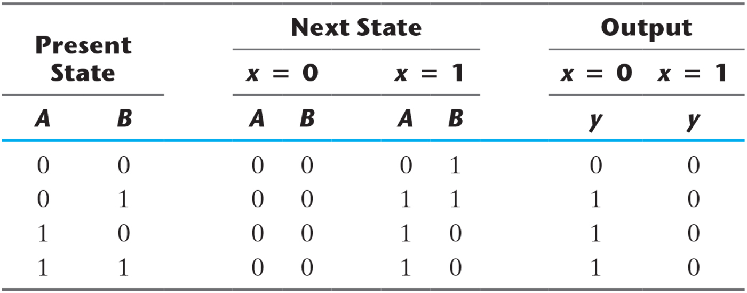
Second Form of the State Table.

Slide 10
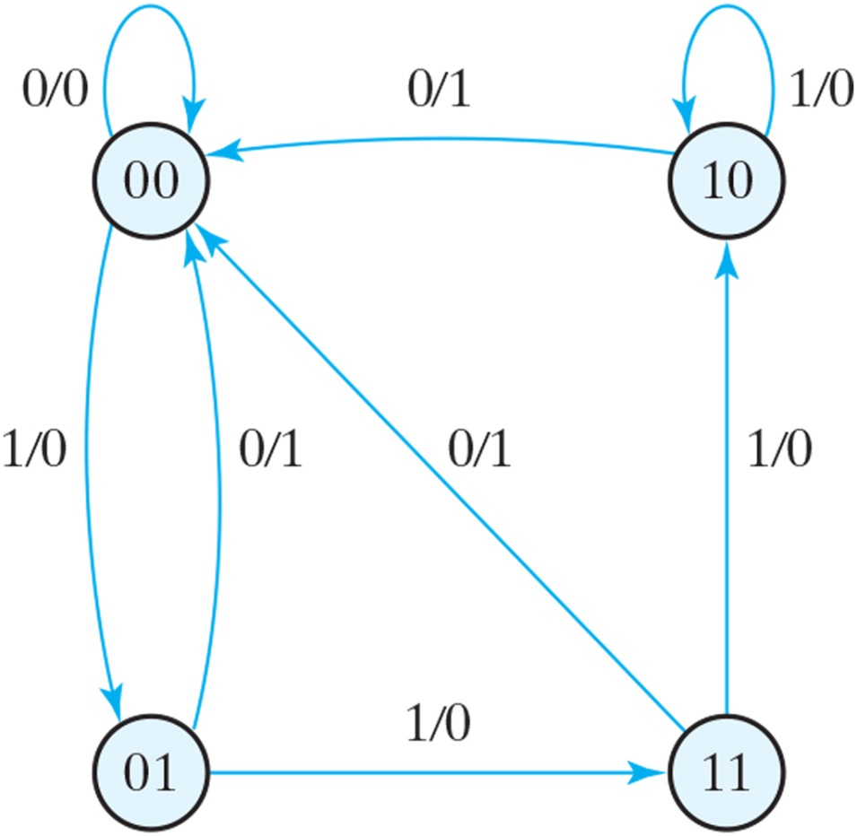
State diagram of the circuit of Example 2.

Slide 11
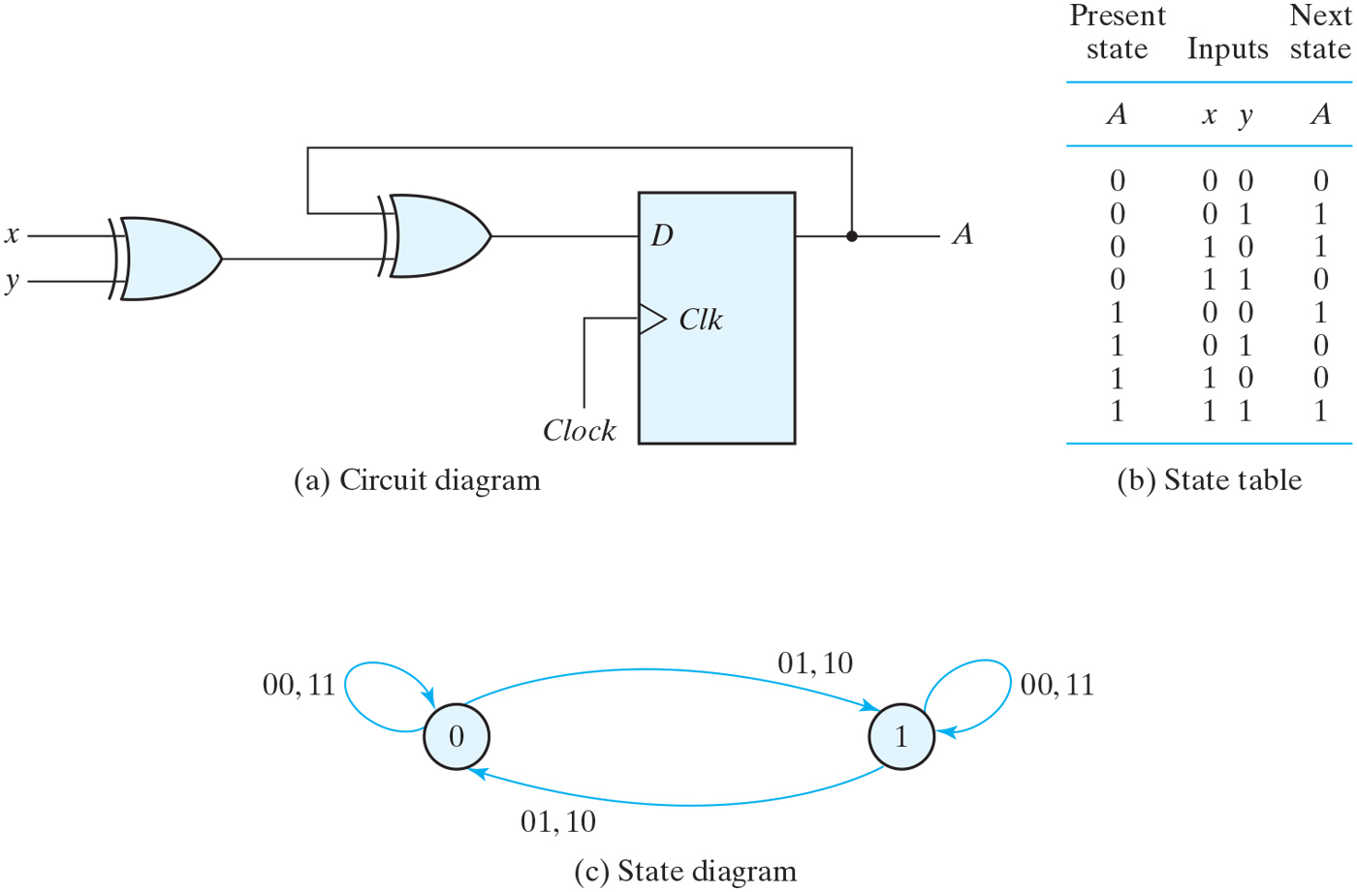
Example 3 Sequential circuit with D flip-flop.

Slide 12
Analysis with JK Flip-Flops
For a D flip-flop, the state equation is the same as the flip-flop input equation
Q(t+1) = D
For JK flip-flops, situation is different
Goal is to find state equations
Method
determine flip-flop input equations
List the binary values of each input equation
Use the corresponding flip-flop characteristic table to determine the next state values in the state table

Slide 13
Example 4: Analysis with JK FFs
x
J_{A}
J
Q
A
K_{A}
C
K
J_{B}
Q
B
J
Q
D
clk
C
C
1
K
K_{B}
y
Flip-flop input equations
J_{A} = and K_{A} =
J_{B} = and K_{B} =

Slide 14
Example 4: Analysis with JK FFs
J_{A} = Bx and K_{A} = x’+B
J_{B} = x and K_{B} = 1
present State
input
next state
FF inputs
A
B
x
A
B
J_{A}
K_{A}
J_{B}
K_{B}
0
0
0
0
0
0
1
0
1
0
0
1
0
1
0
0
1
1
0
1
0
0
0
0
1
0
1
0
1
1
1
0
1
1
1
1
1
0
0
0
0
0
1
0
1
1
0
1
1
1
0
0
1
1
1
1
0
0
0
0
1
0
1
1
1
1
0
0
1
1
1
1

Slide 15
Example 4: Analysis with JK FFs
Characteristic equations
A(t+1) = J_{A}A’ + K’_{A}A
B(t+1) = J_{B}B’ + K’_{B}B
Input equations
J_{A} = Bx and K_{A} = x’+B
J_{B} = x and K_{B} = 1
State equations
A(t+1) =
=
B(t+1) =

Slide 16
State Diagram
0/0
1/1
Present state |  | input | Next state |  | output
A | B | x | A | B | y
0 | 0 | 0 | 0 | 0 | 0
0 | 0 | 1 | 0 | 1 | 0
0 | 1 | 0 | 0 | 0 | 0
0 | 1 | 1 | 1 | 0 | 0
1 | 0 | 0 | 0 | 0 | 0
1 | 0 | 1 | 1 | 1 | 0
1 | 1 | 0 | 0 | 0 | 0
1 | 1 | 1 | 0 | 0 | 1
00
0/0
11
1/0
0/0
0/0
1/0
01
10
1/0

Slide 17
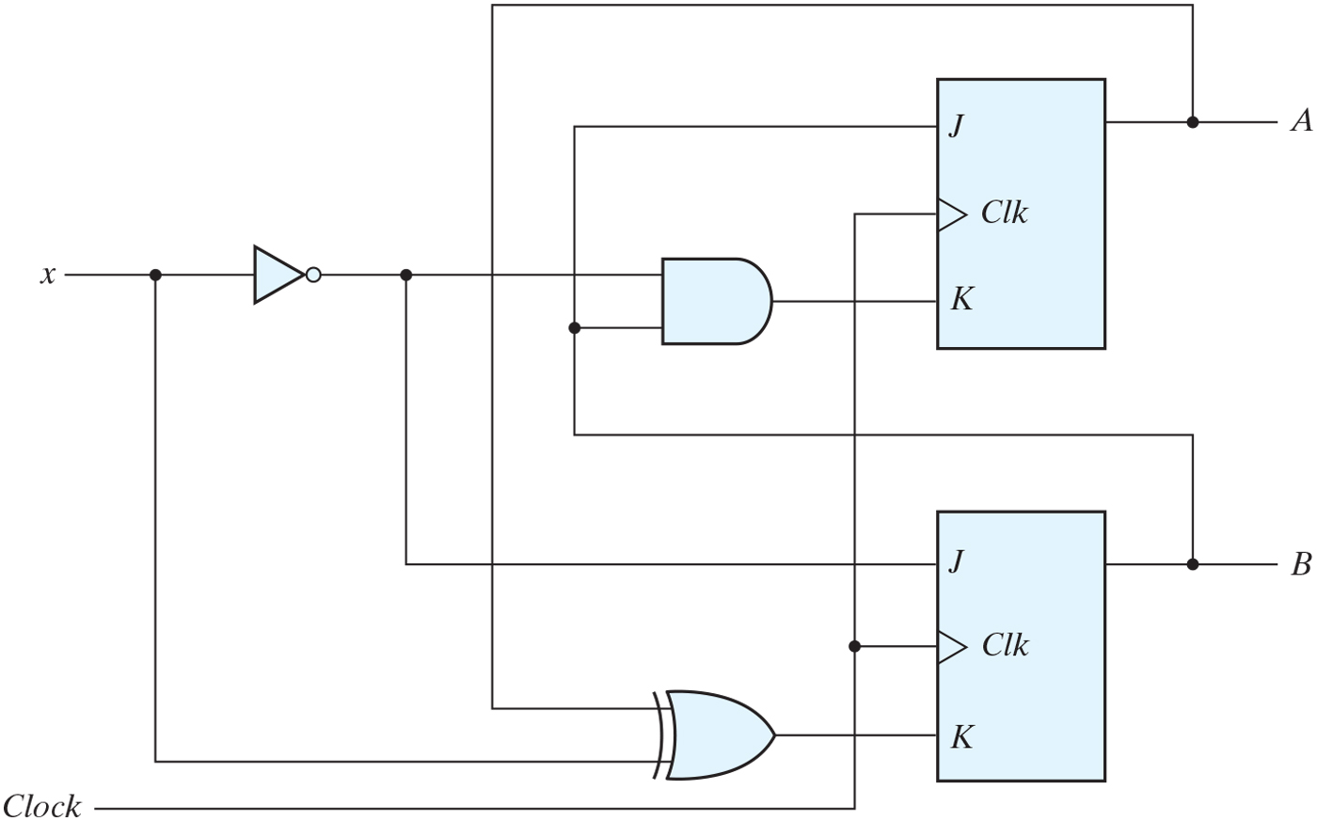
Example 5 Sequential circuit with JK flip-flop.

Slide 18
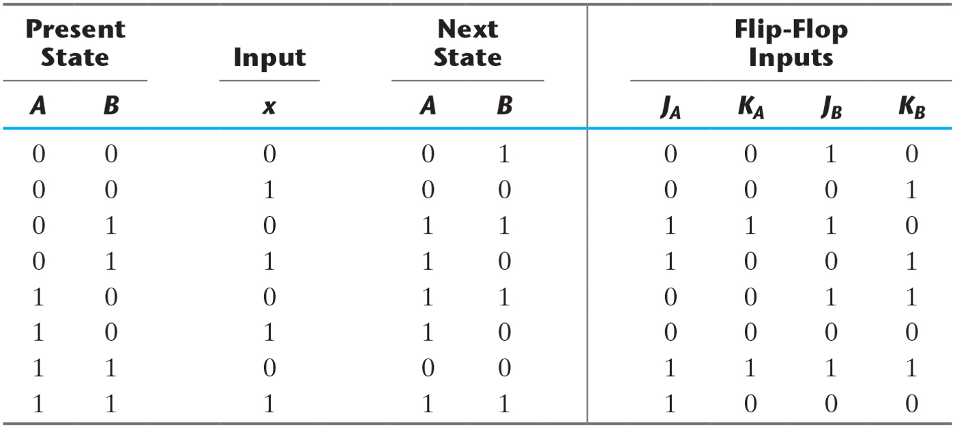
Example 5 State Table for Sequential Circuit with JK Flip-Flops.

Slide 19
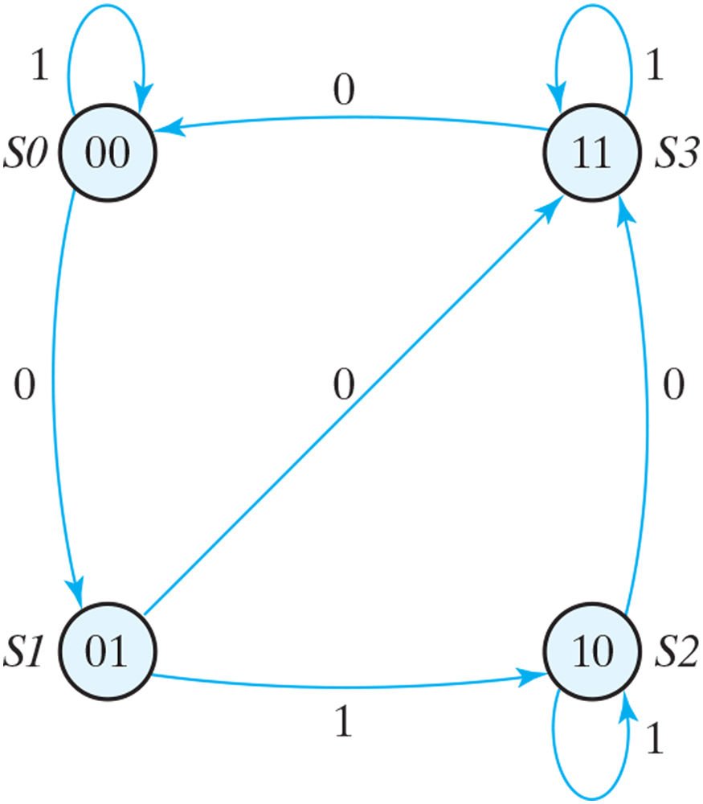
State diagram of the circuit of Example 5.

Slide 20
Analysis with T Flip-Flops
Method is the same
Example 6
T_{A} =
T_{B} =
T_{A}
x
A
T
Q
y₁
C
T_{B}
Q
y₀
T
Q
D
B
clk
C
C
y₁ = A
reset
y₀ = B

Slide 21
State Table & State Diagram
T_{A} = xB T_{B} = x
A(t+1) = xB ⊕ A
B(t+1) = x ⊕ B
0
0
Present state |  | input | Next state |  | FF
A | B | x | A | B | T_{A} | T_{B}
0 | 0 | 0 | 0 | 0 | 0 | 0
0 | 0 | 1 | 0 | 1 | 0 | 1
0 | 1 | 0 | 0 | 1 | 0 | 0
0 | 1 | 1 | 1 | 0 | 1 | 1
1 | 0 | 0 | 1 | 0 | 0 | 0
1 | 0 | 1 | 1 | 1 | 0 | 1
1 | 1 | 0 | 1 | 1 | 0 | 0
1 | 1 | 1 | 0 | 0 | 1 | 1
00
01
1
1
1
11
10
1
0
0

Slide 22
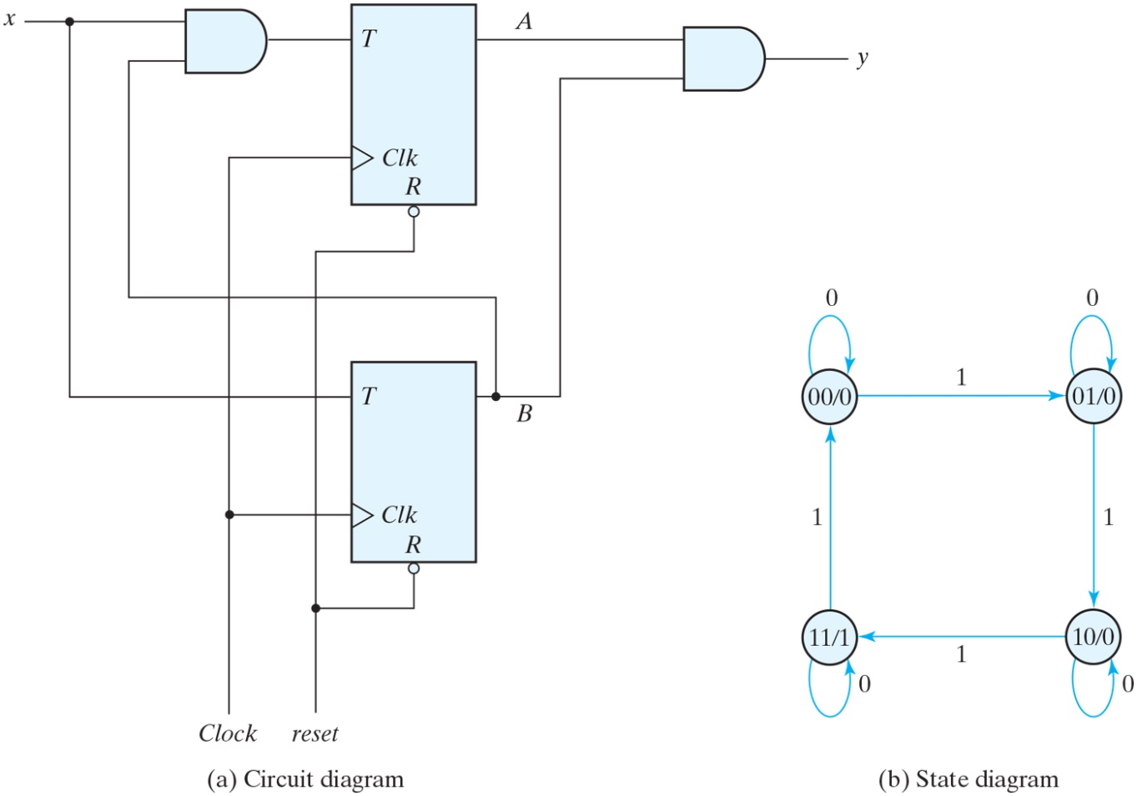
Example 7 Sequential circuit with T flip-flops (Binary Counter).

Slide 23
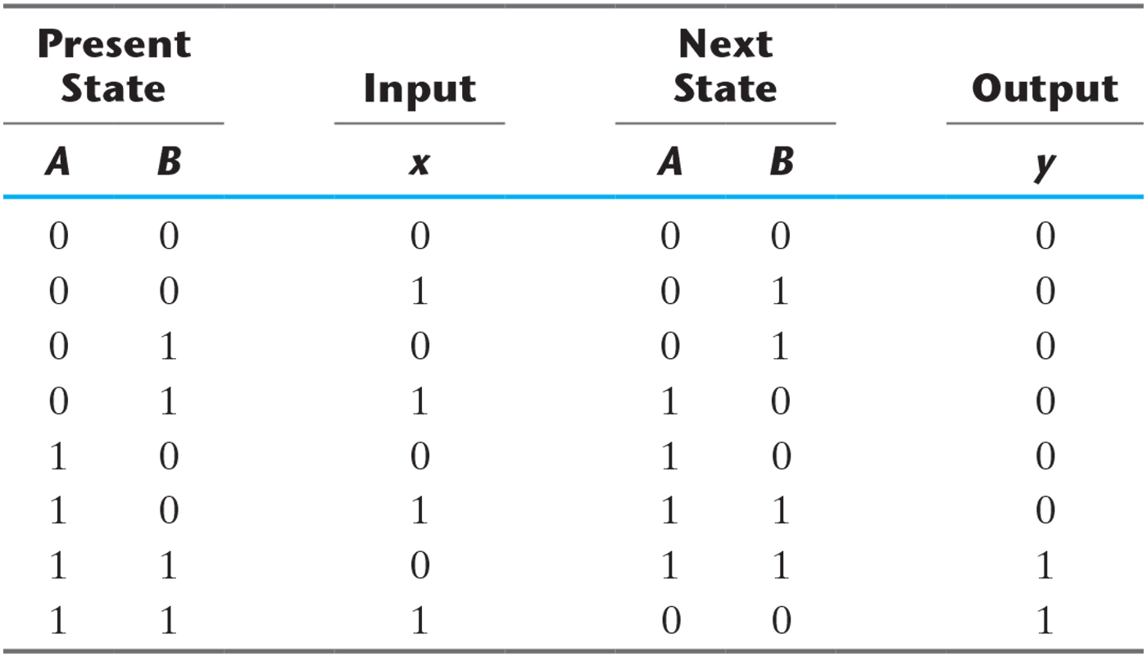
Example 7 State Table for Sequential Circuit with T Flip-Flops.

